Slide 1

Social Engineering Attacks
By Michael, Jaden, Ivan, Amaan, Raul, Abimbola, Danish
CYB-101 Pod 21

Slide 2
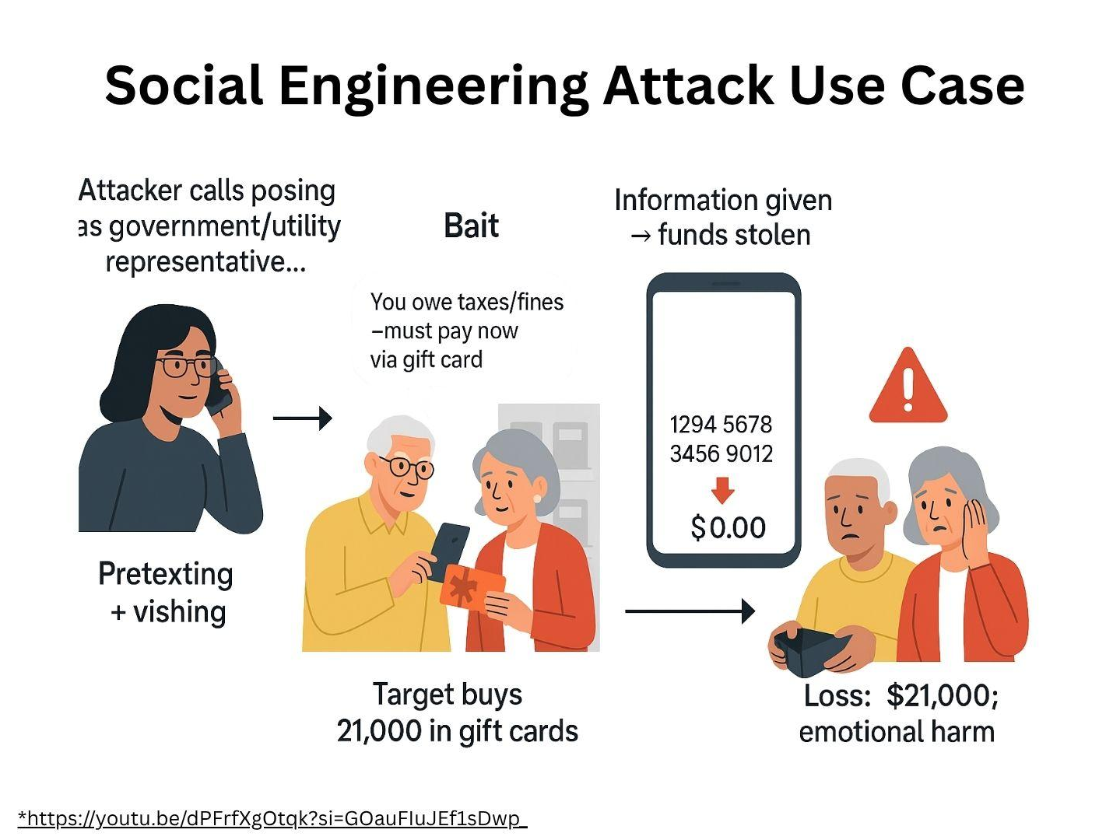
Introduction
Social engineering is the act of manipulating people into revealing confidential information or performing actions that compromise security.
Instead of attacking systems, attackers exploit human psychology, using tactics like:
deception,
urgency, and
trust.

Slide 3
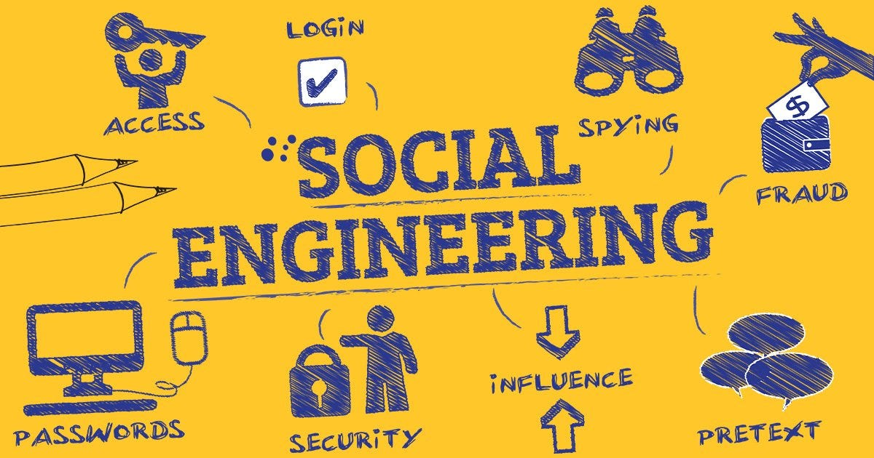
The Potential Risks
Financial Loss: Attackers can gain access to sensitive information where they can steal funds, conduct fraudulent transactions, or hold data for ransom. For some companies, this can lead to financial losses, and it can be quite costly for recovery.
Reputational Damages: A successful social engineering attack can damage a company’s reputation, especially if the customer data is compromised.
Operational Disruption: Social engineering attacks are designed to disrupt business operations. An attacker may gain access to internal systems and shut them down, which can cause significant downtime and loss of productivity.
Legal and Compliance Issues: Organizations that fail to protect sensitive information may face legal consequences. These legal consequences include fines and penalties under data protection laws such as GDPR or HIPAA. These regulations mandate that businesses take necessary steps to safeguard customer and employee data.
Notes:
Social engineering possesses many risks to companies and their customers. From attacks such as phishing, pretexting, and baiting, people loses information concerning their data

Slide 4
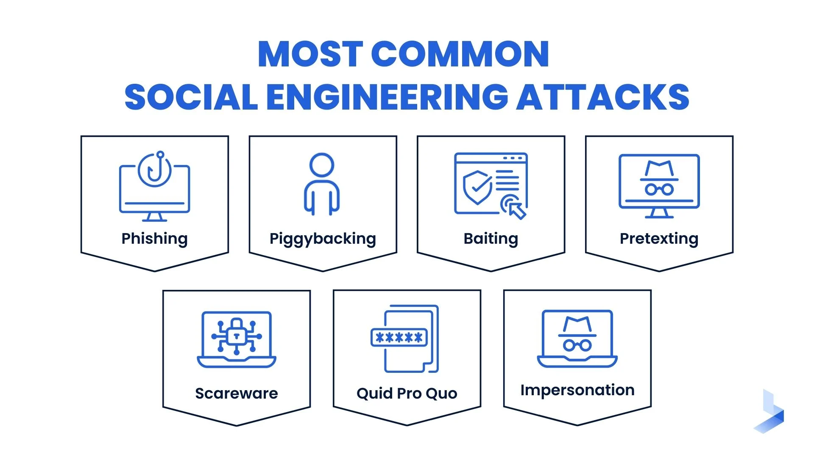
Types of Social Engineering Attacks
Phishing/Vishing: Tricking victims into revealing sensitive information via fake emails, messages, or websites (or phone calls like voice phishing).
Piggybacking: Gaining unauthorized access to a restricted area by following an authorized person.
Baiting: Enticing users with free offers (like USBs or downloads) that deliver malware or steal data.
Pretexting: Creating a fabricated scenario to manipulate someone into divulging information.

Slide 5
Types of Social Engineering Attacks
Scareware: Using fake threats (like virus alerts) to trick users into installing malicious software.
Quid Pro Quo: Offering a fake service or benefit in exchange for confidential information.
Impersonation: Pretending to be someone trusted (like IT staff or executives) to extract information or access.

Slide 6
Mitigations Around It
Mitigation 1 - Security Awareness Training
Educates employees and users to recognize phishing, pretexting, baiting, and other social engineering tactics: Training them:
how to identify red flags
what to do when encountering an attack
who to call in case of an attack
how to handle sensitive data.
Mitigation 2 - Implementing Multi-Factor Authentication (MFA)
Adds a second layer of verification to user login attempts.
Prevents attackers from getting into a system if they don’t have a way to authenticate.
Allows the team to respond to an attacker before they could cause harm, as they would be stuck at the multi-factor authentication layer before they could get in and steal sensitive info.
Mitigation 3 - Least Privilege Access Control
Limits users/employees to what they need for their jobs only. This is helpful, as they disallow employees to give out more info than they should, as they don’t have access to much info in the first place.

Slide 7

Recommendations
1. Employee Training & Awareness: Train staff to recognize social engineering tactics like phishing, vishing, smishing, and pretexting. Teach them to spot red flags such as urgent requests, unusual sender addresses, and suspicious messages.
2. Multi-factor authentication (MFA): Require more than just a password for login—such as a text code or biometric scan—to block unauthorized access and reduce the impact of successful phishing attempts.
3. Email Filtering and Security Tools: Use spam filters and email security solutions to detect and block phishing emails, malicious links, and suspicious attachments before they reach users.

Slide 8
Sources
Source 1- https://www.cmu.edu/iso/aware/dont-take-the-bait/social-engineering.html
Source 2- https://www.cisa.gov/news-events/news/avoiding-social-engineering-and-phishing-attacks
Source 3- https://support.microsoft.com/en-us/topic/what-is-multifactor-authentication-e5e39437-121c-be60-d123-eda06bddf661
Source 4- https://www.hbs.net/blog/importance-of-security-awareness-training
Source 5 - https://www.paloaltonetworks.com/cyberpedia/what-is-the-principle-of-least-privilege

Slide 9


